Slide 1

K
DAC6: Governance, Best Practices and Penalty Mitigation
Keith Brockman, CEO, strategizingtaxrisks.com, U.S.
Emily Dobbie, Senior Manager, TPA Global, The Netherlands
17 June 2020
Transforming the World of Tax
tpa-global.com
Notes:
NOTE: The text shadow is titles that are WHITE.

Slide 2
DAC6: Introduction
Directive 2018/822 (“DAC 6” or “the Directive”) imposes mandatory reporting of cross-border arrangements affecting at least one EU Member State that fall within one of the “hallmarks”.
EU Member States were required to adopt and publish national laws to comply with the Directive by 31 December 2019.
Poland, Portugal and Germany have extended the scope of the Directive in their domestic law (incl. domestic arrangements and VAT).
Guidance on the technical interpretation of the domestic law – still to come in many Member States.
What happens to the reported information? Automatic exchange of information – Common Communication Network (CCN)

Slide 3
DAC6: Observations – practical notes
Legal privilege
Reporting mechanism – web-based form vs. electronic/XML file?
Notification details
DAC6 reporting tools
No specific obligation to actively investigate missing data
Reliance on proof of filing by other intermediaries
Activities of an intermediary not covered by reporting obligation
No exemption from notification obligation

Slide 4
DAC6 optional six-month deferral
30-day timeline
  Currently: commences 01 July 2020
  Proposed (elective): 01 January 2020, including the period between 01 July 2020 and 31 December 31 2020
Historical arrangements between 25 June 2018 and 30 June 2020
  Currently: 31 August 2020
  Proposed (elective): 28 February 2021
Next steps
  Opinion required by the European Parliament (expected by 30 June 2020)
  Unanimous agreement by the Council of the European Union
  Member States formalize their choice to exercise this option; if they fail to respond the original timelines will apply

Slide 5
DAC6 optional six-month deferral
Member State actions
Luxembourg: Penalties will not apply until the amendments come into force
Belgium: Six-month deferral is granted under Belgian legislation
Germany: Historical arrangements originally due by 31 August 2020 can be submitted by 30 September 2020
Implementation options
Use current timelines with potential benefits to test governance, as Member States are still finalizing the original legislation
Wait for Member State actions, although initial deferral proposal on 08 May 2020 did not achieve unanimity
Plan on six-month deferral for reporting, if the relevant Member States for a taxpayer/intermediary announce advance guidance, although current governance timelines should be maintained to remain current with hallmark arrangements

Slide 6

Hallmarks of DAC-6
General hallmarks (A) | Specific hallmarks (B) | Cross-border transactions(C1)
Tax arrangements sold with a confidentiality clause attached Contingent fee Standardized documents and/or structure | Acquisition of Loss Co. Conversion of income into capital, gift or other category of revenue taxed at lower level / exempt Circular transactions resulting in round tripping of funds | Deductible payments to a related party: Which is resident in no or almost no corporate tax jurisdiction If the payment benefits from a full exemption from tax If the payment benefits from a preferential tax regime
Introduction
Text
Cross-border transactions(C2) | Automatic exchange of information and Beneficial Ownership (D) | Transfer Pricing (E)
Deductible payments to a related party which is: Not tax resident in any jurisdiction Resident in black-listed country (EU / OECD) Deduction of the same depreciation on asset in multiple jurisdictions Double tax relief claimed in multiple jurisdictions | Circumvention of reporting obligation on automatic exchange of financial account information Legal structure lacking substantive economic activity where the beneficial owners are unidentifiable | Unilateral safe harbour rules Transfer of hard-to-value intangibles Transfer of functions / risks / assets resulting in EBIT decrease >50% during the next 3 years
Note: With hallmarks A, B, and C1, the main benefit test must be met. The main benefit or one of the main benefits which, having regard to all relevant facts and circumstances, a person may reasonably expect to derive from an arrangement is the obtaining of a tax advantage.

Slide 7
Definitions: a good starting point
Hallmark
A characteristic or feature of a cross-border arrangement that presents an indication of a potential risk of tax avoidance
Arrangement
Undefined; A broad category of transactions, with few exceptions, although defined by several Member States
France: Any agreement, scheme, plan, mechanism, transaction(s)
Ireland: A transaction, action(s), scheme, plan, proposal, promise, undertaking, whether express or implied
Cross-border arrangement
An arrangement between at least one Member State and another country (EU or non-EU), meeting a prescribed condition
Intermediary, meeting one of the following conditions in a Member State:
Tax resident, or
Permanent establishment (PE), or
Incorporated or governed, or
Registered with a professional legal, tax or consulting association
(Legal professional privilege is subject to a filing waiver, determined by the relevant Member State)
Relevant taxpayer
Any person to whom a reportable cross-border arrangement (RCBA) is made available for implementation, or who is ready to
implement a RCBA, or who has implemented the first step of such an arrangement

Slide 8
Main Benefit Test (MBT): Subjectivity
DAC6 Annex IV, Part I: The main benefit, or one of the main benefits, with a reasonable expectation of obtaining a tax advantage
OECD BEPS Action 12, Mandatory Disclosure Rules
  Evolution of DAC6
  The MBT threshold condition requires an objective assessment of the tax benefits
  This quantification, and supporting documentation, provides an objective methodology for documentation comparing the value of the expected tax advantage, if any, with the commercial and economic benefits to be derived
  Member States have generally conformed their guidance, or implicit reference, to DAC6
  Review each relevant Member State for conformity / dissimilarity
Member States exceptions to the objective tests
  France: Legislative intent, and the object of the relevant law, should be considered
    (Would the arrangement have been carried out in the same way if the tax advantage did not exist)
  Ireland: MBT cross-referenced to domestic law – objective and subjective tests are considered
  UK: An almost identical MBT provision is in the UK Disclosure of Tax Avoidance Schemes (DOTAS) re: an intermediary

Slide 9
Hallmark A1: Confidentiality (+ MBT)
A condition of confidentiality is required for a tax advantage, in addition to the MBT
Arrangements via email, verbal or written agreement
M&A arrangements generally meet the MBT
Interpretations by several Member States
Confidentiality clauses to protect a commercial, industrial, trade or commercial secret would not meet this hallmark
Best Practices
Use Member State interpretations, providing a concise summary of each type of NDA (e.g., procurement, engineering, etc.)
Quantify the tax advantage, or lack thereof, via a sample of each functional NDA provided by a Member State
Ensure (EU) legal counsel is knowledgeable of this hallmark
Develop a 30-day governance procedure, acknowledged by (EU) legal counsel
Insert a DAC6 clause in future agreements for clarification and reporting coordination by an intermediary

Slide 10
Hallmark A2: Intermediary (+ MBT)
An intermediary is any person that provides, directly or by means of other persons, aid, assistance or advice with respect to designing, marketing, organizing, making available for implementation or managing the implementation of a RCBA
The language of this hallmark re: a tax advantage would automatically meet the MBT
An in-house tax department may be an intermediary, based upon Member State interpretation (e.g., France, Germany)
The obligation to report the arrangement shifts to the relevant taxpayer when:
(i) the intermediary is a non-EU intermediary, or
(ii) no intermediary (i.e., an in-house arrangement), or
(iii) taxpayer is notified that an intermediary has the right to a waiver due to legal professional privilege
Best Practices
Insert DAC6 intermediary language in each relevant statement of work to formally outline each party’s responsibilities
Document timing to report the arrangement, noting DAC6 Article 8ab specifying the first to occur of three conditions
Determine if the obligation to report the arrangement has shifted to the taxpayer
If an intermediary is reporting an arrangement, coordinate draft DAC6 reporting language, obtain filing verification numbers, evidence
Review an EU tax department to verify if it is considered an intermediary by the relevant Member State

Slide 11
Hallmark A3: Standardized documentation (+ MBT)
A ”plug-and-play” standardized arrangement fulfilling the MBT, available to more than one relevant taxpayer without substantial customization = Broad interpretation
Member State interpretations
France: A standardized share savings plan is a reportable arrangement
Germany: White List exceptions to reporting:
  Granting of loans
  Licensing
  Employee secondments
  Service agreements
Best Practices
Refer to Germany’s “white list” as documentation reportable in other Member States
Document “substantial customization” or MBT language for transactions not reported
Develop 30-day governance for various functions re: cross-border arrangements
`

Slide 12
Hallmark B1: Tax losses to reduce tax liability (+ MBT)
A series of contrived steps to acquire a loss-making company, terminate its main activity and taking advantage of those losses to reduce its liability in one or more jurisdictions
The language of this hallmark would automatically meet the MBT
Member State interpretations
Germany:
  If loss utilization is restricted by law, the acquisition should not be disclosed
  Includes companies with loss carryforwards or current losses
  A lack of economic reasons presumes an avoidance or circumvention of tax
Best Practices
Document economic reasons for the respective steps, including COVID-19
Document the series of steps, or lack thereof, with contemporaneous documentation
Differentiate the company’s main activity, if applicable

Slide 13
Hallmark B2: Income conversion (+ MBT)
A conversion of income, an an income producing asset (e.g., note receivable) to equity
The language of this hallmark would automatically meet the MBT
Member State interpretations
France: Converting fee revenue into a dividend distribution
Sweden: Distributing a dividend-in-kind to its shareholder
Best Practices
Require tax approval, pre-execution, for all intercompany distributions to/from an EU entity
Review tax disclosures for historical arrangements on or after 25 June 2018

Slide 14
Hallmark B3: Circular / offsetting transactions (+ MBT)
“An arrangement which includes circular transactions resulting in the round-tripping of funds, namely through involving interposed entities without other primary commercial function or transactions that offset or cancel each other or that have other similar features”
The language of this hallmark would automatically meet the MBT
Member State interpretations
France: Intercompany royalty agreement that reduces sales margin earned by the licensee due to the offsetting transactions is a reportable arrangement
Germany: Common examples include sale-leaseback and cash pool transactions
Best Practices
Be aware of (partial) offset, or netting of transactions, that may be reportable
Review, and document, flow of funds to/from EU entities for historical arrangements
Review, and document cash pool transactions

Slide 15
Hallmark C1(a): Payments to non-resident recipients
Intercompany cross-border tax deductible payments to a recipient that is a non-resident for tax purposes in any tax jurisdiction (MBT does not apply)
Member State interpretations
France: Recipient - Person liable to pay tax (partners of the transparent company)
Residence: Use bilateral tax convention, or Article 4 of OECD Model Tax Convention
Spain: Payment – includes cross-border charges, irrespective if payment was made, or will be deemed made via indirectly through interposed persons or entities
UK: Recipient – Partners, vs. partnership, will determine if this hallmark applies
The amount treated as payable is the amount treated as payable for tax purposes
Best Practices
Document if an accrual, vs. cash, basis will be used to determine reporting for Hallmark C (presumable DAC6 data will be used to match tax return information)
For an accrual basis taxpayer (using the accrual basis), consider including in reporting summary
Identify partnerships, or single-member LLC’s, that would be considered a non-resident

Slide 16
Hallmark C1(b)(i): Payments to nil taxed recipients (+ MBT)
Intercompany cross-border tax deductible payments to a recipient of a low tax country imposing corporate tax at the rate of zero or almost zero (MBT does apply)
The language of this hallmark would automatically meet the MBT
Member State interpretations
France: An effective tax rate of less than 2% is considered to be ”almost zero”
Germany: A corporate tax rate of less than or equal to 4% is “almost zero”
Netherlands: An “almost zero” rate should mean a rate between -0-% and 1%
Spain: A corporate tax rate below 1% is considered to be “almost zero”
Sweden: A zero rate refers to the nominal tax rate, applicable to the particular kind of income and not to entities taxed at a zero rate (e.g.,UAE)
Best Practices
Document position of using a “statutory” tax rate vs. effective tax rate

Slide 17
Hallmark C1(b)(ii): Payments to blacklist jurisdictions
Intercompany cross-border tax deductible payments to a recipient’s tax jurisdiction that is included in a non-cooperative list assessed by EU or OECD (MBT does not apply)
Member State interpretations
France: Conforms to EU or OECD blacklist
Germany: Requirements for non-cooperative jurisdictions must be met at time of notification
Spain: EU list is not applicable; reference is to Spanish Law 36/2006 of 29 November
UK: A country must be both on the EU blacklist at time of first step of arrangement and on 01 July 2020 to be relevant
Best Practices
Document EU and OECD (or local) blacklists to determine hallmark eligibility

Slide 18
Hallmark C1(c): Payments subject to a tax exemption (+ MBT)
Intercompany cross-border tax deductible payments to a recipient’s tax jurisdiction that benefits from a tax exemption in its tax jurisdiction (MBT does apply)
The language of this hallmark would automatically meet the MBT
Member State interpretations
France: Payments which would not give rise to taxation by reason of setoff, deduction of losses or other deductible charges, deduction or imputation of taxes paid abroad, are deemed to benefit from a full tax exemption
Germany: A full exemption from tax is assumed if the payments are not included in the tax base of the taxing state due to exemptions in domestic and treaty law, tax allowances, tax loss reliefs or tax credits
Best Practices
Document if the payment benefits from a tax benefit (e.g. dividend), as determined by the Member State
Determine if payments are setoff, resulting in an assumed tax exemption

Slide 19
Hallmark C1(d): Payments to a preferential tax regime (+ MBT)
Intercompany cross-border tax deductible payments to a recipient’s tax jurisdiction that benefits from a preferential tax regime (MBT does apply)
The language of this hallmark would automatically meet the MBT
Member State interpretations
France: Payments must be preferential in the relevant country, and not in other countries
Germany: A patent box regime is reportable, even if it complies with modified OECD nexus
Sweden: Reportable for Dutch innovation box and UK patent box regimes
UK: A regime meeting criteria of the Forum on Harmful Tax Practices (FHTP) will be considered a preferential tax regime (Countries, including US, still under investigation)
Best Practices
Document if there are patent or innovation box regimes, etc. for relevant transactions that would be reportable

Slide 20
Hallmark C2: Payments for an asset receiving depreciation benefits in more than jurisdiction
Intercompany cross-border tax deductible payments where an asset receives the benefit of depreciation in more than one jurisdiction (MBT does not apply)
Member State interpretations
Germany: An aircraft leasing transaction, where lessor and lessee each claim depreciation in their jurisdiction on the basis of their respective domestic legislation, is reportable
UK: This hallmark does apply if the associated profits are taxed in both jurisdictions
Best Practices
Document if there are dual-resident companies, or similar arrangements, that are applicable

Slide 21
Hallmark C3: Double tax relief claims in > 1 jurisdiction
Intercompany cross-border tax deductible payments where double tax relief is claimed for the same item in more than one jurisdiction (MBT does not apply)
Member State interpretations
Germany: Includes situations involving three jurisdictions in which an exemption from double taxation is applied in two different jurisdictions due to qualification/allocation conflicts
Best Practices
Document if there are potential reporting arrangements

Slide 22
Hallmark C4: Asset transfer with material amount differences
Intercompany cross-border tax deductible payments for an asset transfer with a material difference in amounts recorded between those jurisdictions (MBT does not apply)
Member State interpretations
Germany: A difference of 10% or less is not material and not reportable
Spain: A difference of more than 25% is a material difference
UK: A material difference includes exploitation of tax system mismatches to an unintended outcome
Best Practices
Document if there are valuation differences for applicable asset transfers (e.g., applying different discount rates for net present values)

Slide 23
Hallmark E1: Unilateral safe harbour rules
An arrangement which involves the use of unilateral safe harbour rules (MBT does not apply)
Member State interpretations
France: The definition of unilateral safe harbour rules is the same as the OECD Transfer Pricing Guidelines in Chapter IV, Section E
Germany/NL/Sweden: OECD safe harbour rules are not unilateral safe harbour rules; not reportable
Best Practices
Document what arrangements fall within OECD safe harbour rules, and requirements of the relevant Member States
OECD rules are international rules, and not intended to be characterized as unilateral safe harbours

Slide 24
Hallmark E2: Intangible transfers
An arrangement which involves the transfer of hard-to-value intangibles (MBT does not apply)
Best Practices
Treat any intangible transfer as subject to reporting if there are no comparables

Slide 25
Hallmark E3: Transfer of functions, assets and/or risks
An arrangement which involves the intergroup transfer of functions, assets and/or risks if the projected EBIT, during the 3-years after the transfer, are less than 50% of projected annual EBIT of such transferors if the transfer had not been made (MBT does not apply)
Member State interpretations
Netherlands: Commercial EBIT (vs. tax EBIT) should be used
UK: The 50% EBIT must be considered at the level of the individual company rather than at the level of the sub-group that is located in the same jurisdiction
Best Practices
Treat the EBIT definition as earnings before interest and taxes
Document which projections are used for this determination
COVID-19 effects are not an exception to reporting

Slide 26
Penalties per Arrangement (not reported)
Up to €15,000
Bulgaria
€20,000 - €30,000
Croatia
Above €60,000
Ireland
€30,000 - €60,000
Estonia
Finland
France
Hungary
Lithuania
Latvia
Cyprus
Czech Republic
Germany
Malta
Slovakia
Sweden
Romania
Austria
Belgium
Denmark
Luxembourg
Netherlands
Poland
Portugal
Slovenia
Spain
United Kingdom

Slide 27
Penalty Mitigation
Member States have not finalized rules for penalty mitigation, however general guidelines to mitigate, or minimize, potential penalties include the following:
Defensible position for not reporting based on interpretation of the rules
Maintaining internal control procedures and policy compliance

Slide 28

Questions?
How will you mitigate the risk of non- compliance?
Are you in control?

Slide 29
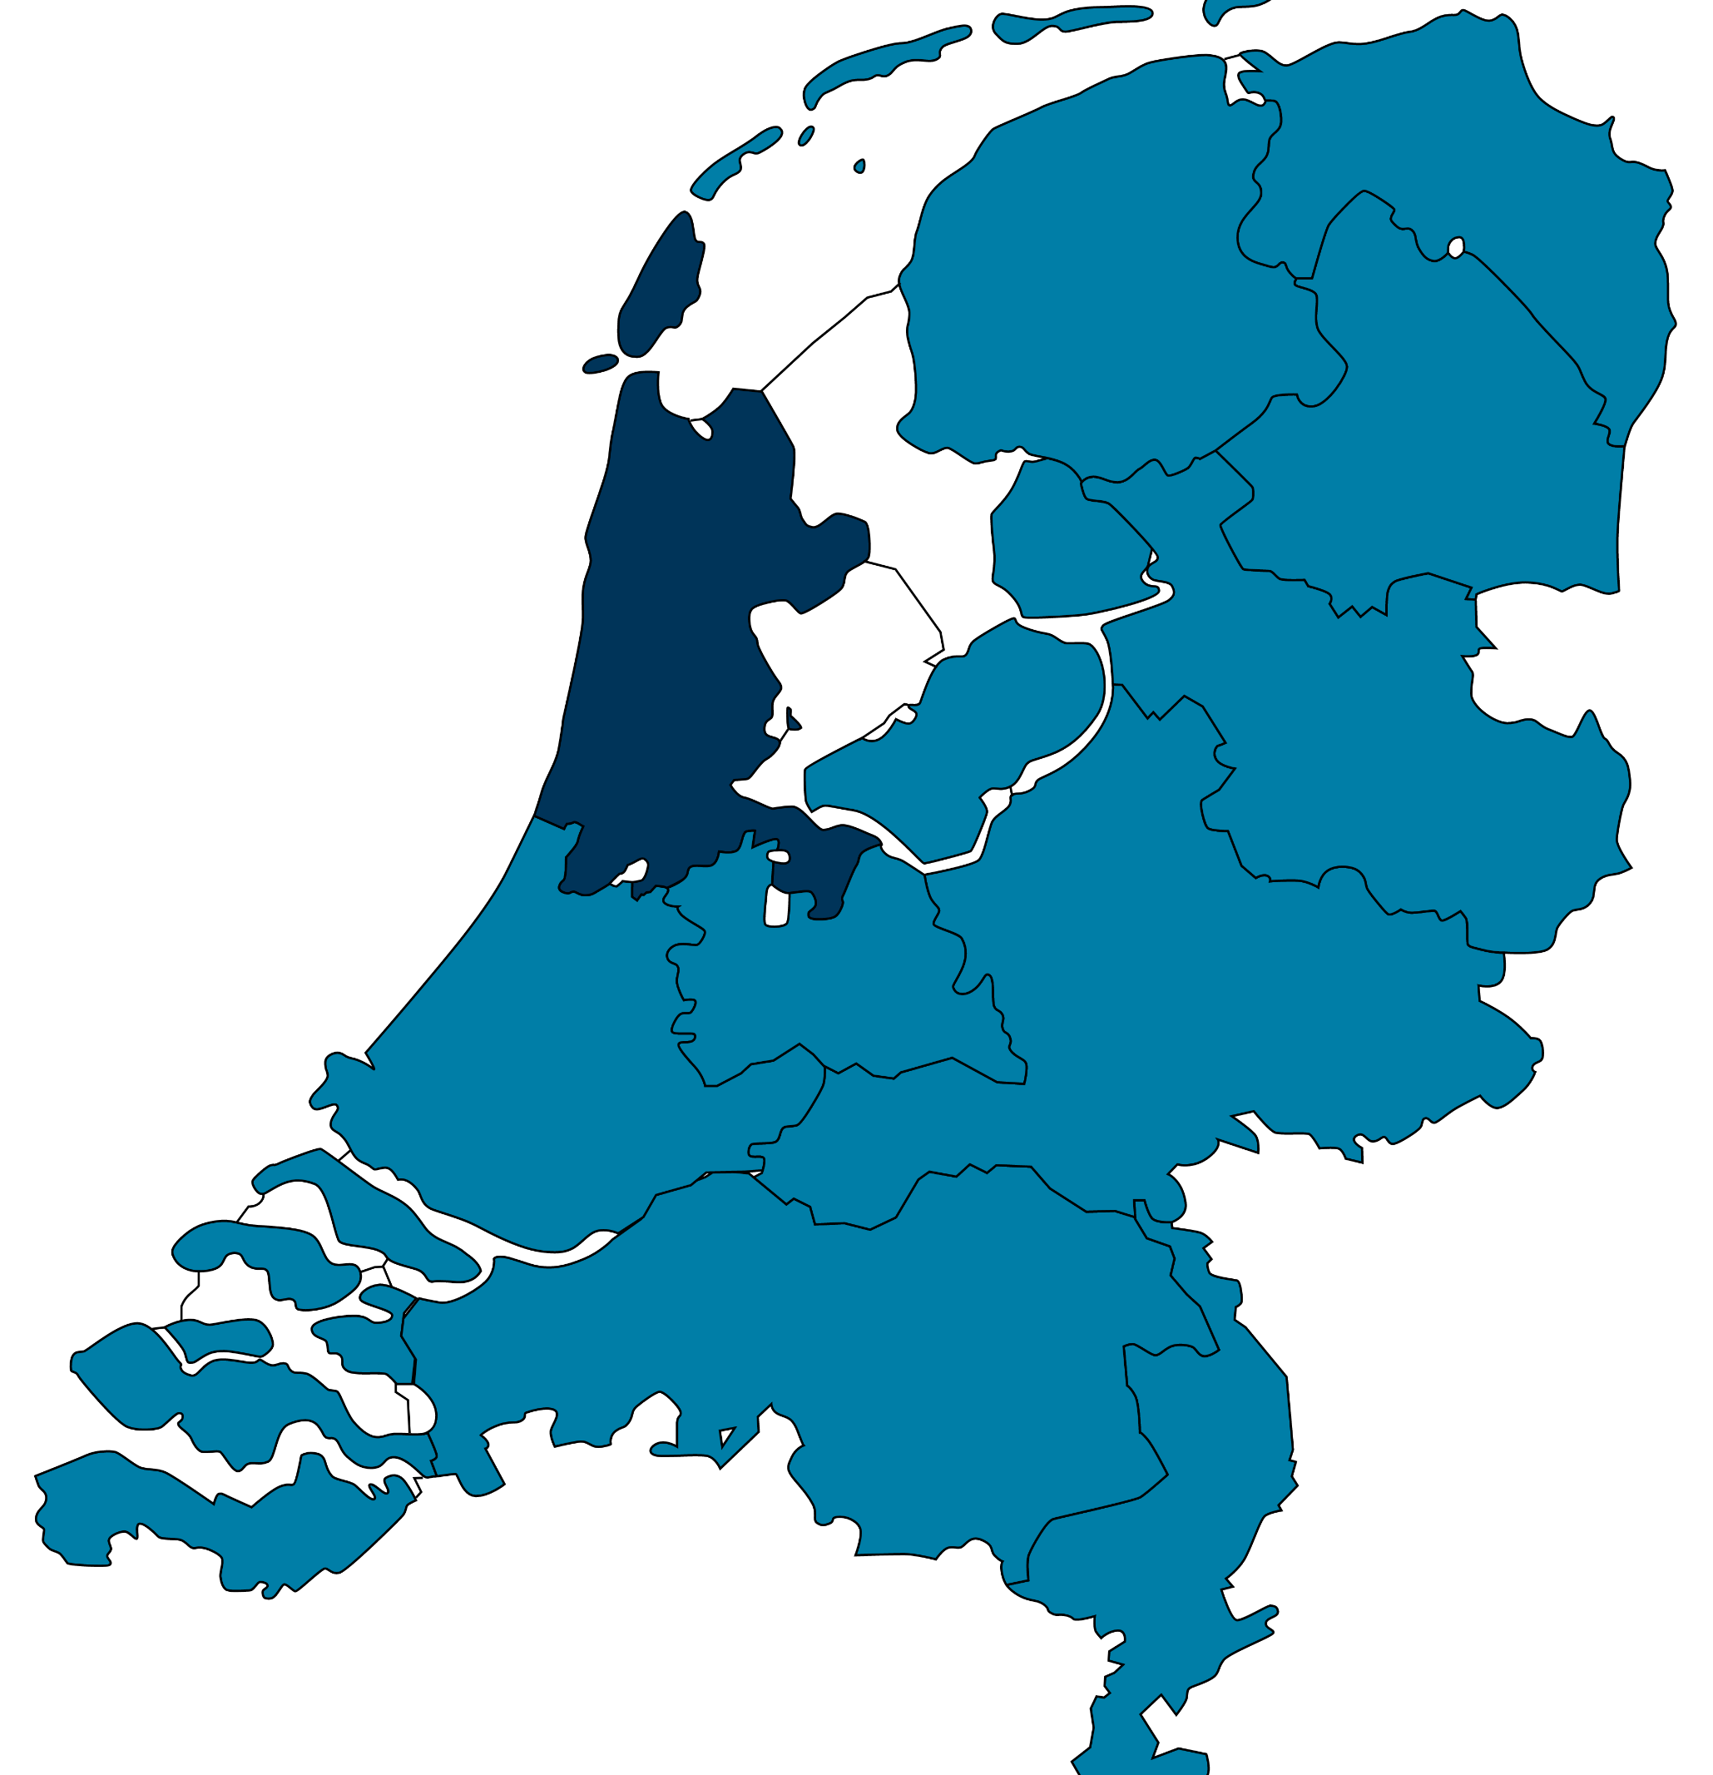


Get In Touch
Transforming the World of Tax
info@tpa-global.com
Headquarters:
H.J.E. Wenckebachweg 210
1096AS Amsterdam
The Netherlands.
+31 20 462 3530
www.tpa-global.com
Find Us

Slide 30
Thank
You
Our global network covers over 5,000 professionals who enable us to deliver scalable solutions in the area of tax & legal, digital transformation, running a compliance factory and effectively dealing with dispute resolution.
To ensure the highest quality and seamless service provision, thereby meeting international standards and regulations, a global team of dedicated professionals and specialists is a key and determining factor.
Through linking three ecosystems: Tax, Transfer Pricing and Valuation, Tax + Technology and Tax Litigation and Mediation – we deliver a world of tax in control.
H.J.E. Wenckebachweg 210 . 1096 AS Amsterdam . The Netherlands . +31 (0)20 462 3530 . tpa-global.com
The views expressed and the information provided in this material are of general nature and is not intended to address the circumstances of any particular individual or entity. The above content should neither be regarded as comprehensive nor sufficient for making decisions. No one should act on the information or views provided in this publication without appropriate professional advise. It should be noted that no assurance is given for any loss arising from any actions taken or to be taken or not taken by anyone based on this publication.
© 2020 V. All Rights Reserved.

